Slide 1
Deep learning Computing on ARM devices
4/28/2019

Slide 2
Introduction
Hand-coding Computing libraries
Generation optimization direction
Auto-coding stack: Halide/TVM

Slide 3














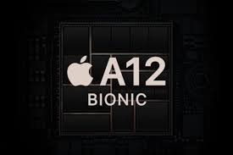
Embedded devices overview
High level Abstract
CPU
Origin
Custom
Custom
GPU
Mali
Adreno
DSP
Hexagon
Custom Complier
VP6/7/C5
Assemble level coding
NPU
Custom Complier
Generally, the peak performance of CPU:GPU:DSP = 1:1:1; power consumption of CPU:GPU:DSP = 4:2:1
CPU is the most flexible (suit third party app dev), GPU and DSP is more efficient(suit for vendor app)

Slide 4
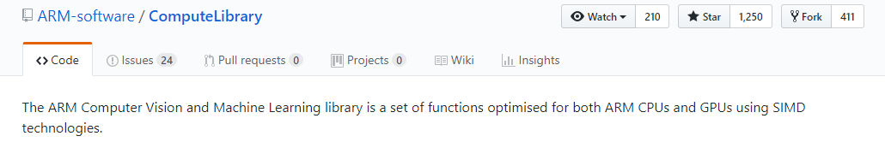
DNN libraries(1): arm computing library
https://github.com/ARM-software/ComputeLibrary
Function:
Basic arithmetic, mathematical, and binary operator functions
Color manipulation (conversion, channel extraction, and more)
Convolution filters (Sobel, Gaussian, and more)
Canny Edge, Harris corners, optical flow, and more
Pyramids (such as Laplacians)
HOG (Histogram of Oriented Gradients)
SVM (Support Vector Machines)
H/SGEMM (Half and Single precision General Matrix Multiply)
Convolutional Neural Networks building blocks (Activation, Convolution, Fully connected, Locally connected, Normalization, Pooling, Soft-max)mathematical, and binary operator functions
Comment:
Most flexible computing library, support almost all known operators
FP32/FP16 spport for both CPU NEON and GPU OpenCL
Three kinds of implementation for conv
Im2col + gemm
Imcol + Winograd gemm
Direct conv
Well document/code style
Performance seems not good, everyone claims beaten of it

Slide 5
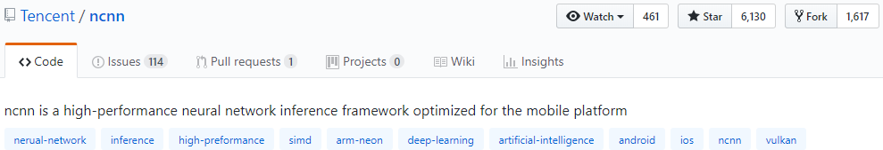
DNN libraries(2): Tencent NCNN
https://github.com/Tencent/ncnn
Function:
Classical CNN: VGG AlexNet GoogleNet Inception ...
Practical CNN: ResNet DenseNet SENet FPN ...
Light-weight CNN: SqueezeNet MobileNetV1/V2 ShuffleNetV1/V2 MNasNet ...
Detection: MTCNN facedetection ...
Detection: VGG-SSD MobileNet-SSD SqueezeNet-SSD MobileNetV2-SSDLite ...
Detection: Faster-RCNN R-FCN ...
Detection: YOLOV2 YOLOV3 MobileNet-YOLOV3 ...
Segmentation: FCN PSPNet ...
Comment:
Computing library + framework
support most common used operators
FP32/FP16 support for both CPU NEON and GPU vulkan
Fix point computing / 8 bit quantization
Multiple platforms: x86/arm/ios/android/linux/windows
Memory-efficient / Production level code
QQ, Qzone, WeChat, Pitu and so on.
Support to import models from caffe/pytorch/mxnet/onnx
No third party libraries dependent
Custom layer supported
Good reputation in the beginning, but stuck in large amount of burden

Slide 6
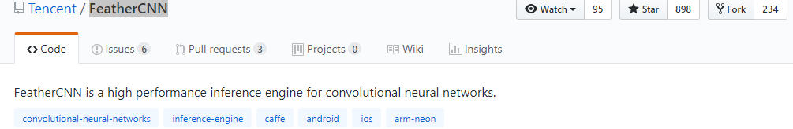
DNN libraries(3): Tencent FeatherCNN
https://github.com/Tencent/FeatherCNN
Function:
Less support than NCNN
Only CPU support
Origins from our game AI project for King of Glory (Chinese: 王者荣耀)
Comment:
Seems to be a result of horse racing mechanism inner Tencent

Slide 7
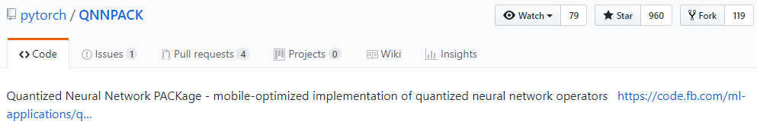
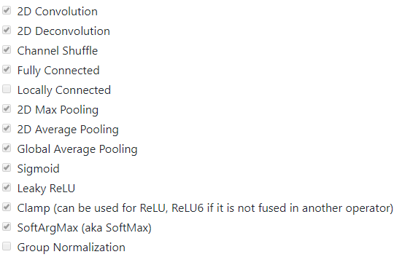
DNN libraries(4): Facebook QNNPACK
https://github.com/pytorch/QNNPACK
Function:
Mainly for computing on quantized 8-bit tensors.
QNNPACK is integrated in pytorch1.0 with Caffe2 graph representation
Comment:
Android/IOS
CPU only
Highly support with the integration of Pytorch
8-bit tensors oriented
FP16/Fixed16 on the way

Slide 8
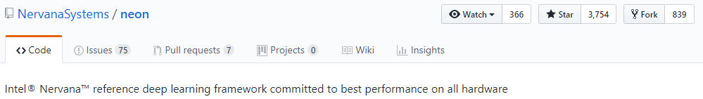
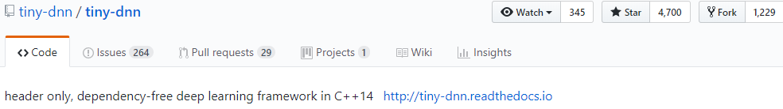
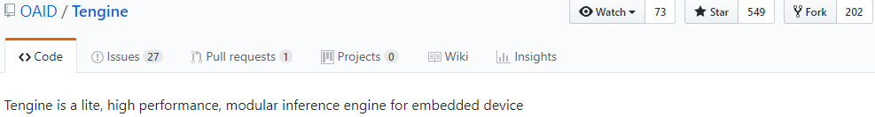
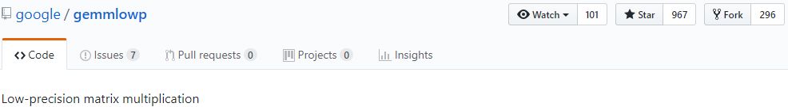
DNN libraries(5): others
1. https://github.com/NervanaSystems/neon
A startup bought by Intel
2. https://github.com/tiny-dnn/tiny-dnn
Two authors totally, give up maintain
3.https://github.com/OAID/Tengine
By Open AI lab
4. https://github.com/google/gemmlowp
Only Gemm(INT8/Short16/FP16/FP32; CPU only)
Origin as PC libraries but also compatible with ARM platform (CPU only)
5. OpenBlas / Eigen

Slide 9
How to use
One time on Host
Libraries SRC
build
Libraries so/header files
Every time on host
Host side cross-compile
Link
Framework parser
Computing Libraries inner representation
Wrapper
Executable
Custom network
App
Device side

Slide 10
Generation optimization direction
Overall speaking, a program is bounded by
Memory
Computing
Trick to estimate the gap
memcpy benchmark to get insight of memory bandwidth
math function benchmark to get computing ability
Performance
Performance
Computing Complexity
Memory Access
(1) Computing Bound Program
(2) Memory Bound Program

Slide 11
Kernel optimization
Tricks:
Performance comparison(Apple2Apple)
Clean system, same frequency, result accurate
Get basic understand of the system
If memory bound, consider:
Layer fusion / quantization / weight share / data reuse
Cache hint rate
If computing bound:
Reduce algorithms complexity
ALU frequency/ ALU pipeline
CPU
GPU
DSP
ALU
ALU
ALU performance
L1
….
L1
L1
….
L1
DATA SRAM
Instruction SRAM
L2
L2
Endpoint bandwidth
MMU
DDR bandwidth
DDR

Slide 12
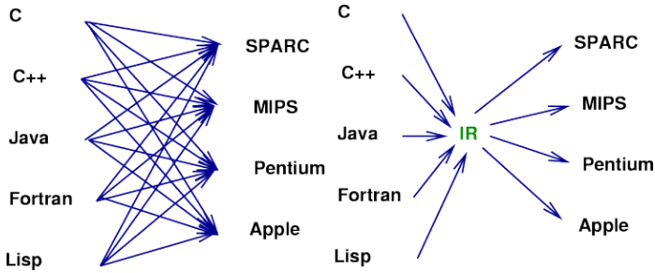
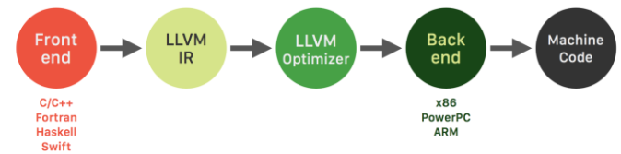
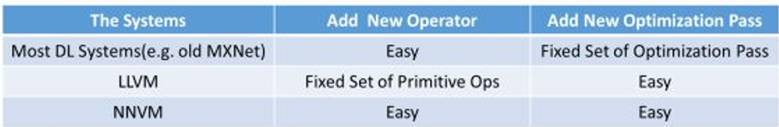
Auto-coding stack
Terminology:
LLVM
NNVM / TVM
IR
Halide
NNVM?

Slide 13
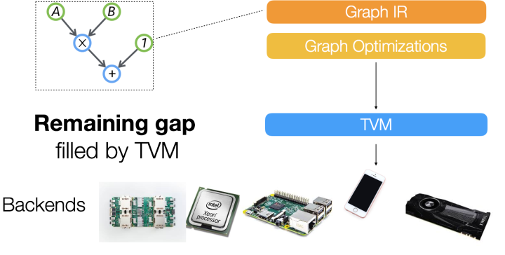
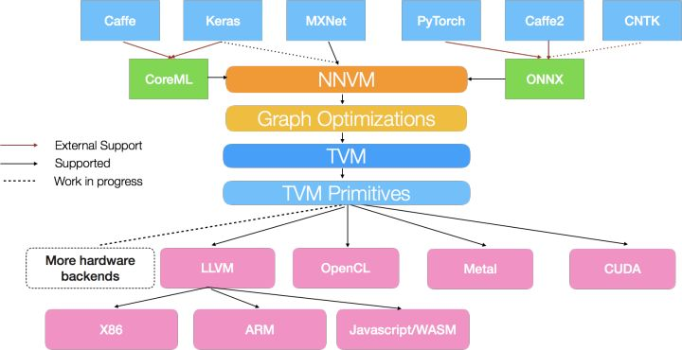
TVM/LLVM
NNVM:
Just another framework?
TVM:
Second level IR
Code Generator && Feedback

Slide 14



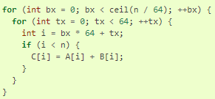
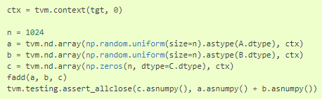
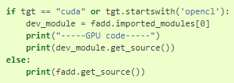
TVM
Code Generator:
Separation of Data flow and Execution flow

Slide 15
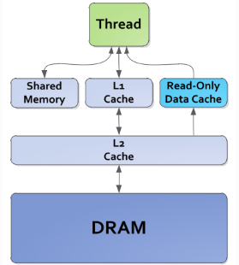
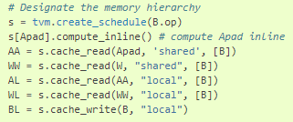
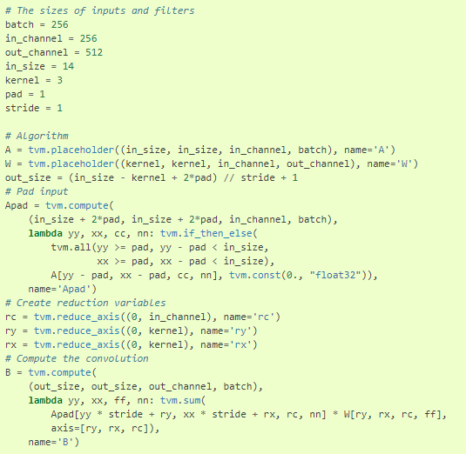
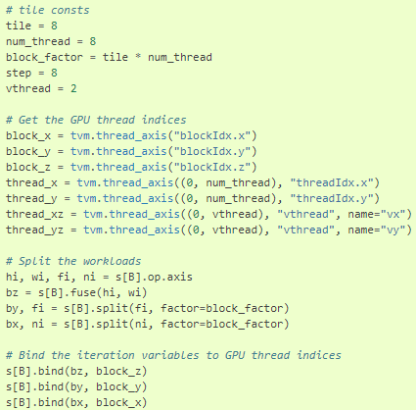
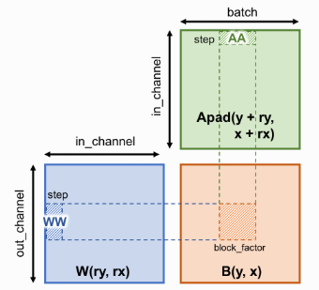
TVM
Code Generator (GEMM)
a
b

Slide 16
Q & A

